Slide 1


Models in Engineering
Week 4: Models in Verification and Validation
Project
Name

Slide 2
Instructions
Before you begin, you should save your Project Portfolio on your local drive. We recommend the following format:
Lastname_Firstname_Course2_Week4
Please note: You will not be able to re-download your file after submission; therefore, please keep this file in a central location for future reference.
The work in the project deliverable is individual.
You will be self-assessing your work as well as the work of three peers. If you have any questions, feel free to post to the Discussion Forum.
Although work is strictly individual, sharing ideas and concepts with other students is encouraged.
Note: edX has a 10MB file size limit for document submission. If you have selected large image(s), you may need to resize before submitting, OR you may simply include a web URL for the image in the image location. Be sure to submit your assignment at least one hour before the deadline to provide time for troubleshooting.
Once the deadline passes, you will not be able to upload the document and therefore will not be able to submit and complete the assignment.

Slide 3
Week 4 Project
Overview
In the fourth and final project activity of this course, you will choose a product/system/sub-system you have worked on. You will then develop the V&V framework and determine the V&V techniques and V&V plan of those models.
Note that some Scratch Pages are included at the end of this document for you to capture any ideas, sketches, etc. that you have as you work through the project. These will not be assessed and you are not required to submit them with your project (but you may do so if you think they offer any additional insight into your thinking process!).
REQUIRED STEPS:
Step 1: Develop the V&V framework
Step 2: Develop the V&V options
Step 3: Elaborate on one model
Step 4: Review and submit your project

Slide 4
Step 1: Develop the Verification and Validation Framework
Dr. Anna Thornton talked about determining the V&V framework of your system from a product, process, and business perspective. Here you will focus on just product and process.
A. Choose a scope -- for example, bicycle models 1,2,3 built at the Charleston, SC assembly plant, or software product A.
B. For the grey boxes (the framework labels), decide whether these are appropriate names in your industry. If they are not appropriate, please change the names.
C. For the blue boxes, customize the generic questions to your industry. You don’t need to answer the questions here; just write an example question in each box.
Scope :
 | Product | Process
System (including environment)
Sub-system/Function
Part
Feature

Slide 5
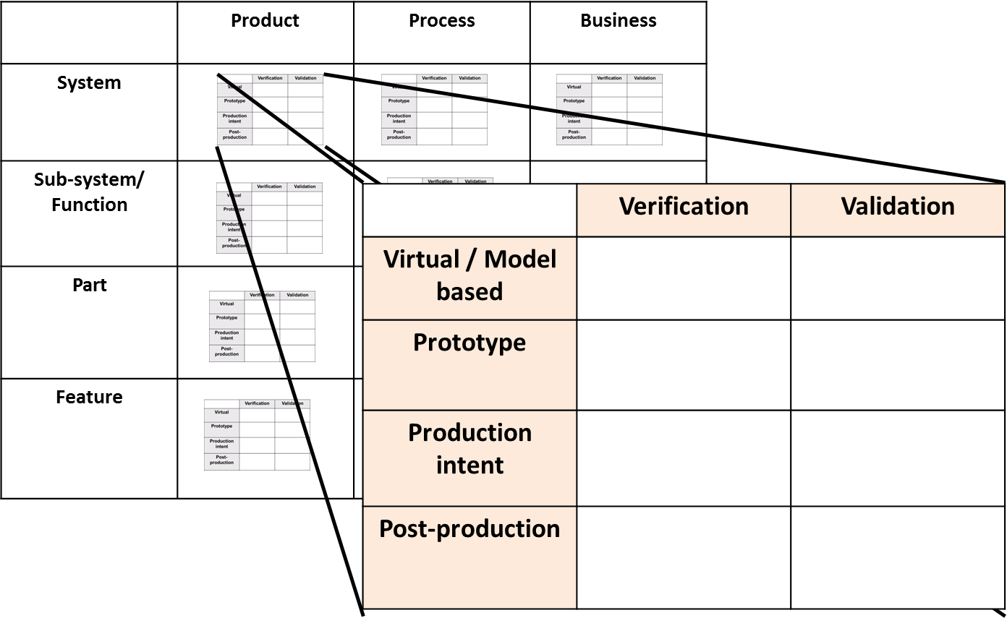
Step 2: Develop the Verification and Validation Options
If you changed the grey boxes in Step 1, please change them in the table below as well.
For each empty box in the framework below, describe a potential V&V method you could employ. You may employ the same method in multiple boxes. In reality you may not need all 32 types of V&V – you might choose to use a model only for subsystem function V&V.
 | Product |  | Process
System | Models |  | Models
 | Prototype |  | Prototype
 | Production Intent |  | Production Intent
 | Post-production |  | Post-production
Sub-system/ Function | Models |  | Models
 | Prototype |  | Prototype
 | Production Intent |  | Production Intent
 | Post-production |  | Post-production
Part | Models |  | Models
 | Prototype |  | Prototype
 | Production Intent |  | Production Intent
 | Post-production |  | Post-production
Feature | Models |  | Models
 | Prototype |  | Prototype
 | Production Intent |  | Production Intent
 | Post-production |  | Post-production

Slide 6
Step 3: Elaborate on One Model
For one of the eight potential models you identified in Step 2, do the following:
A. State the name of the product on which it would be used, and give a brief explanation of the product.
B. Highlight one or two critical issues that this model would help you verify and/or validate. For example, a critical issue could be, “Will the software crash under any operating conditions?”
C. Provide a potential name of the model, and a brief description of how the model does or should work.
D. On a scale of 1 (low) – 10 (high), describe how well you think the model will accomplish the V&V task.

Slide 7
Step 4: Review and Submit Project
Submit your completed Week 4 Project Portfolio file
Note: The maximum file size that can be submitted is 10MB.
Assess both your own file and your peers’ completed Week 4 Project Portfolios against the Week 4 scoring rubric and determine how well you and your peers
The scoring rubric can be downloaded from the course in the Resources/Downloads tab on the top navigation.

Slide 8
Scratch Page*
Reminder: edX has a 10MB file size limit for document submission. If you have selected large image(s), you may need to resize before submitting, OR you may simply include a web URL for the image in the image location. Be sure to submit your assignment at least one hour before the deadline to provide time for troubleshooting.

Slide 9
Scratch Page*
Reminder: edX has a 10MB file size limit for document submission. If you have selected large image(s), you may need to resize before submitting, OR you may simply include a web URL for the image in the image location. Be sure to submit your assignment at least one hour before the deadline to provide time for troubleshooting.

